Slide 1
Lecture 8
Smart Contract vulnerabilities and testing

Slide 2
Software Development Lifecycle
Idea to prototype

Slide 3
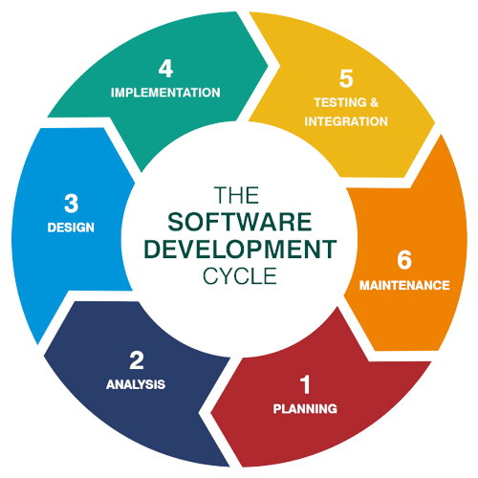

6 Stages of SDLC
Security risks, edge case, stress testing
Actual code development, debugging
UI/UX, psychological factors
Product Architecture, libraries, licenses, etc
Continuous improvement, product competitive analysis, consumer feedback integration
Requirements and Risks
Financial - users? gas?
Technical - faster, better data?
What problem is our software solving / market being captured?
Timeline, teams, budget.

Slide 4

Testing - protection against users

Slide 5
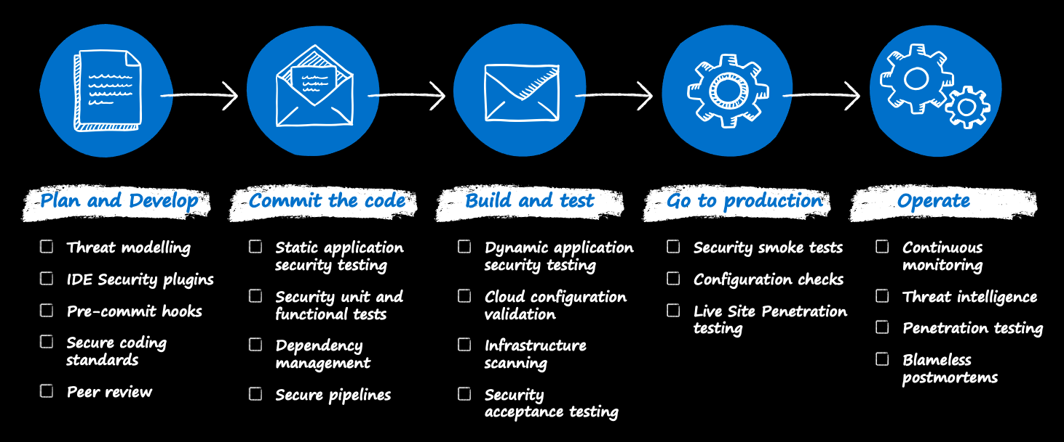
From DevOps to DevSecOps

Slide 6
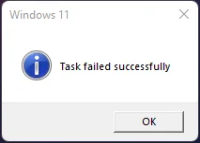
Functional Tests
Functional- works as expected?
Non-functional - can it handle simultaneous connections? Is it cheap?
Unit Test
Test small chunks - units. Can be a function, interface, module.
Write tests as you code!
Test expected failures and event emissions.
Test edge cases.
Problem - cannot test private functions
Integration Test
Different modules tested as an entity.
Checks conditions unit testing cannot detect - code interaction
Either logical test suites or black box testing.

Slide 7
Common Attacks

Slide 8
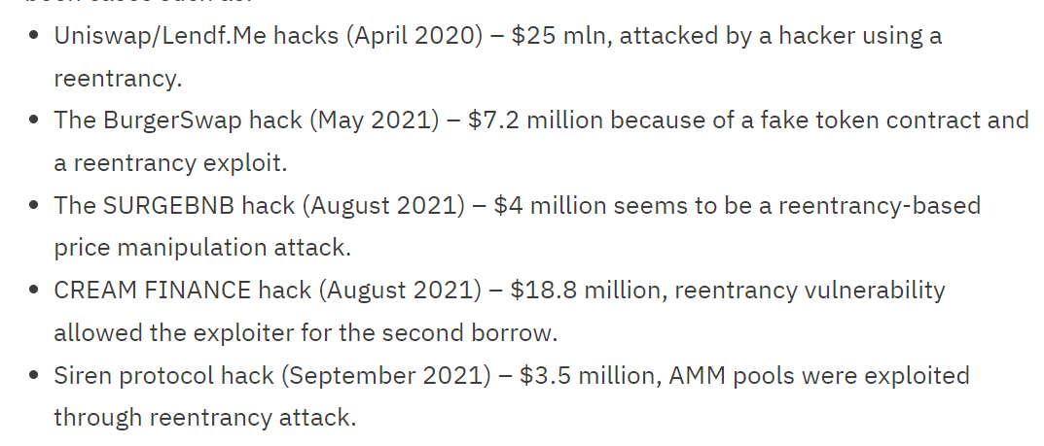
Reentrancy Attack
Contract Bank {
function withdraw(uint amount){
msg.sender.call(value: amount);
}
}
3. Fallback function calls withdraw again! Re-enters the Bank
1. Request withdraw
2. Bank sends, goes to fallback function
Contract Attacker {
function attack() external payable{
withdraw();
}
fallback() external payable {
Bank.call("withdraw()");
}
}
Simulate in Remix!

Slide 9
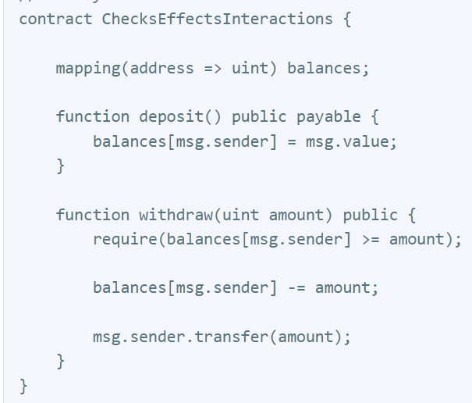
Reentrancy Guards
Check-Effect-Interaction coding pattern
Reentrancy Modifier
  A modifier which contains a bool which turns true the first time a function is call in a transaction
  Prevent recursive calls from external contracts and itself.
Pull payments
  Do not allow direct push contract interactions
  To withdraw, users/contracts make a payment request and then call a separate withdraw pool themselves instead of the contract sending.
Pausable Contract
  Contract logic of what to do in an emergency

Slide 10



Denial of Service Attacks
Bandwidth exhaustion
Server Storage overflow
Processing power monopoly
Set forwarding rule:
When I receive an email from Gmail 2,
Forward a copy to dauphine
Send a copy back to Gmail 2
Each iteration of the infinite loop, Dauphine receives a copy
Set forwarding rule:
When I receive an email from Gmail 1,
Forward a copy to dauphine
Send a copy back to Gmail 1

Slide 11
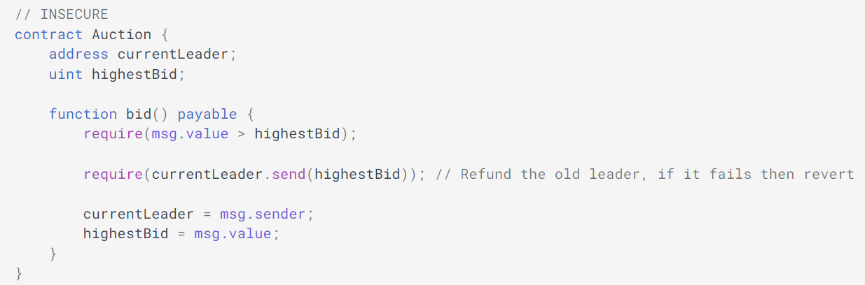
Denial of Service Attacks - Forced Revert
Very frequent on the internet, not just web3. Cause the service to fail from unexpected behaviour.
What if the current leader has a fallback function that rejects any attempt to send money?

Slide 12
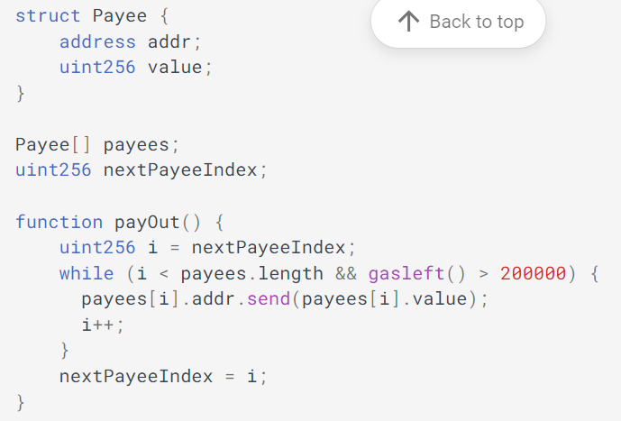
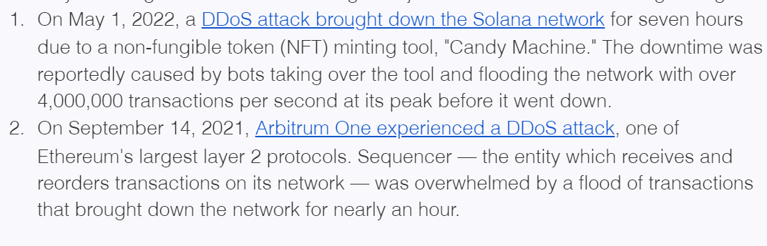
Denial of Service Attacks - Gas Limit
The dangers of dynamic arrays - a payout for contributors example
Choke the contract with requests → Remember Black Thursday?
How about a bot contracts which floods the blockchain with useless blocks for a set period of time?

Slide 13
Griefing - Business Logic Attack
1. Malicious but compliant attacks to disrupt business operations.
A group staking contract which pays dividends 24 hours after last deposit.
Attacker keeps on putting tiny deposit amount to ensure payouts keeps on getting delayed.
2. Insufficient Gas Griefing - Wallet and Relayers
A malicious relayer can first pose as legitimate transaction handler, get wallets to send them transactions, then purposefully set a small gas limit, resulting in no transactions ever go through.
3. Self destructing contracts
The self destruct command erases a smart contract and force sends the remaining ether to a target address. Deprecated by EIP-6049 in 2022.

Slide 14
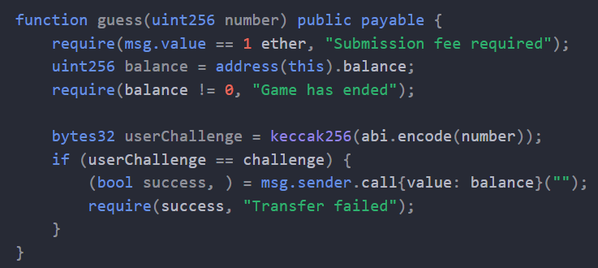
Toxic MEV - Front Running
Scan for a winning transaction
Simulate the transaction on a fork of the chain
Submit your transaction with a much higher gas limit

Slide 15
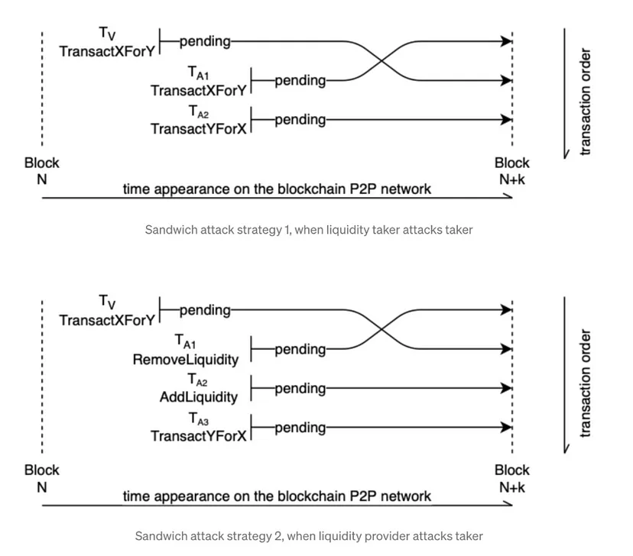
Toxic MEV - Sandwich Attack
Victim identifies arbitrage opportunity
Copy the transaction and pay higher gas
victim suffers slippage
Two transactions lowers price of Y against X, trade all Y forX.
Provider sees large order for Y.
Remove all liquidity for Y in that pool.
Victim suddenly pays high X for little Y.
Provider refills pool with Y, normalizing price again.
Buys X with remaining Y.

Slide 16
Code level vulnerabilities
Integer under and overflow, patched in Solidity 0.8.0 onwards
Pseudo-random number generation
  block level parameters can be deduced/calculated.
    block.timestamp
    block.number
Incorrect parameter ordering
  Solidity do not name parameter inputs. Make sure the ordering is correct for structs and functions with many inputs.

Slide 17
Defensive Programming
Aim for simplicity
  Less lines of code is cheaper
  Less code = less room for mistakes
Be as private as possible
  Public functions and variables are expensive and potentially open to manipulation. Always try to keep things private.
  Use external / internal above public.
Reuse secure code
  Copy code from the internet. But copy secure code. Openzeppelin, Safe, Eth, etc.
  Refactor as much as possible. Aggregate similar features into a library.
Write readable code
  Natspec commenting as much as possible
  Clear variable names, follow conventions
Test! Test! Test!

Slide 18
Cyber Security
&
Smart Contract Auditing

Slide 19
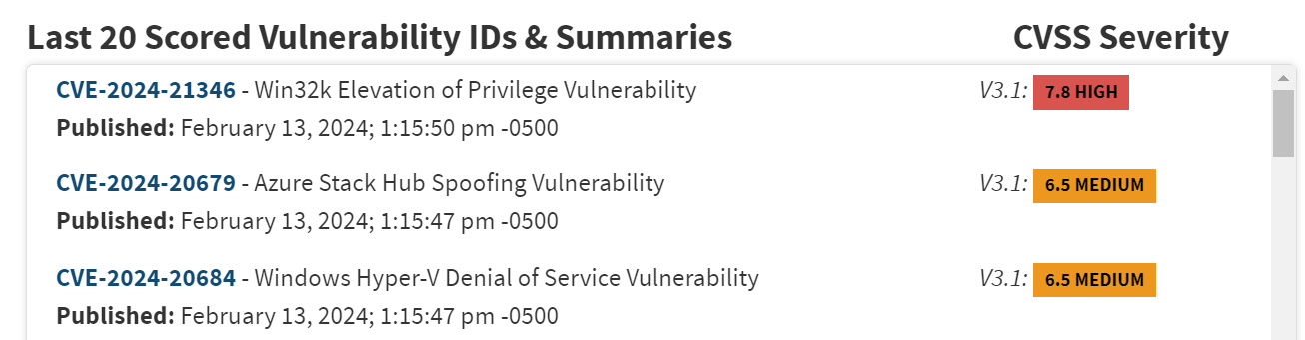
Vulnerability Registries
Cyber Security is a never ending race of discovering vulnerabilities. All vulnerabilities are tracked on registries.
- CWE, CVE, OWASP Top 10, NVD, SWC, SCSVS
Registries differ by area (OWASP is web), vulnerability approach (CWE - flaws/weakness pattern vs CVE - named vulnerability)

Slide 20
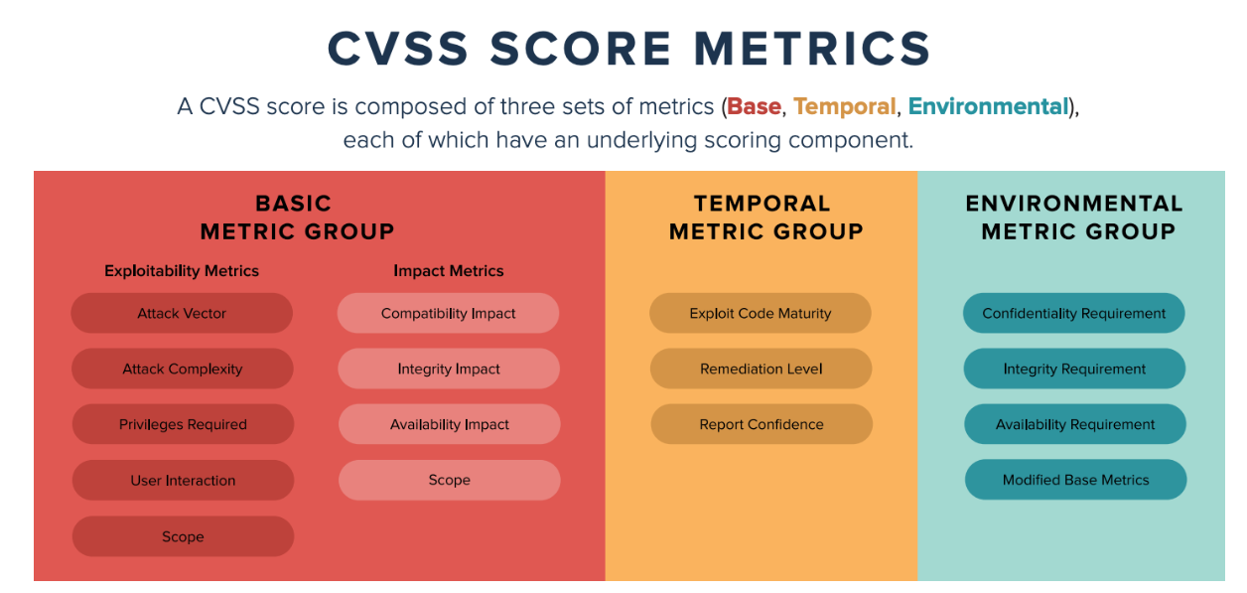
CVSS - Common Vulnerability Scoring System

Slide 21


Static / Dynamic Scanners
Static Scanning
In depth code analysis
Auto detection of vulnerable coding practices
Building of intermediate execution flows and recognise attacks
Taint analysis - detect injection attacks which corrupt data and memory
Dynamic Scanning
User POV testing
Send malicious requests
Network attacks and stress testing
User behaviour modelling. In the real world, perhaps your user fell victim to social engineering?
List of scanners

Slide 22
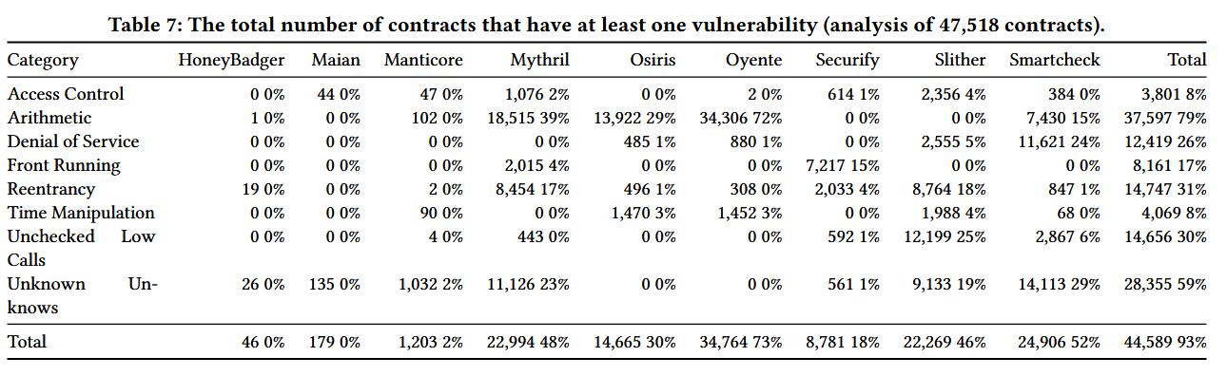
No solution is perfect
False positives? False negatives?
Source

Slide 23
Audit Lifecycle
1. Documentation
2. Automated Testing
3. Manual Review
4. Vulnerability Classification
5. Reporting
Code freeze and scope agreement.
Provide all specifications, system architecture and intended execution of system.
Dynamic and Static scanning.
Formal Verification.
Custom test suites.
Humans are better at detecting logic errors, poor coding patterns and business manipulations like gas attacks.
Analysis of code with consultation to original goals and specifications.
A list of vulnerabilities with their risk levels.
Provide recommended resolution techniques.
** Note:
From a business perspective, each vulnerability is a cost. Weigh it against the cost of the exploit.
Provide initial report with findings.
Provide further consulting for the client.
Most Web3 projects release their audits publicly to gain confidence from the public.
Cost: $5000 - $15000

Slide 24
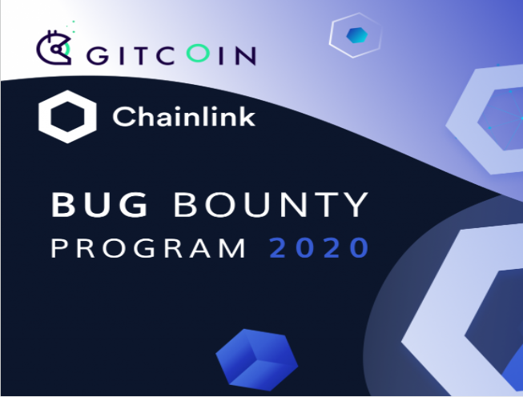

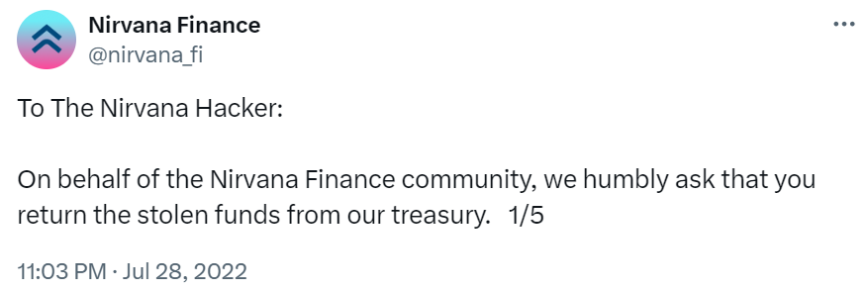
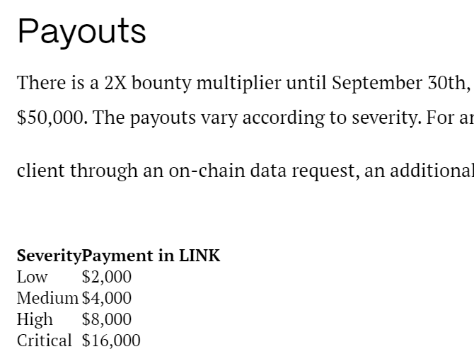
Social Bug Finding
The "please give our money back" method
First account of Indictment

